Slide 1
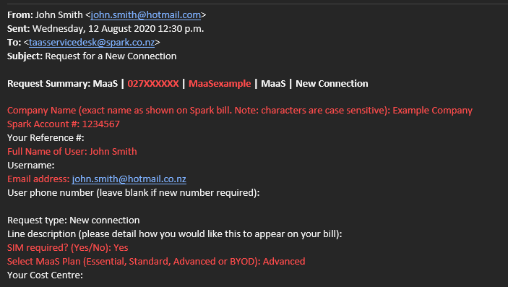
Request Form Instructions
To make a request, please follow the below steps:
Select which form to use based on the request required. Note: If you also have a Spark End Point Management service, please use the forms later in the pack.
Complete the details on the page. Items marked in red are mandatory
Copy and paste the Email subject and Email body into a new email and send to taasservicedesk@spark.co.nz
See example below of what the email should look like:
Your request will then be actioned by the Service Desk and you should receive email notifications along the way.

Slide 2
Use this email template to request for a number to be removed from your Mobility as a Service account, for example an employee leaving.
Form: Leaving User
Email subject: MaaS Request for a Leaving User
Email body:
Request Summary: MaaS | <insert mobile number> | <insert username> | MaaS | Leaving user
Request Details
Company Name (exact name as shown on Spark bill. Note: characters are case sensitive):
Spark Account #:
Your Reference #:
Full Name of User to be removed:
Username:
Email address:
Leaving user mobile phone number:
Leaving user device IMEI:
Line description:
Your Cost Centre:
Delivery address for return courier bag to be sent
Note: you will need to send the device and SIM back to us within 30 days. Please package carefully before placing in the return courier bag.
Site contact name:
Site contact number (#):
Delivery address:
Company Name
Attention:
Address line 1:
Address line 2:
Town or City:
Post Code:
Additional comments:

Slide 3
Use this email template to let us know about a lost or stolen device. We will arrange for a replacement to be shipped out to you as soon as possible.
Form: Lost or Stolen Device
Email subject: MaaS Request for a Lost or Stolen Device
Email body:
Request Summary: MaaS | <insert IMEI of lost stolen device if known> | <insert mobile number of lost/stolen device> | <insert username>
Company Name (exact name as shown on Spark bill. Note: characters are case sensitive):
Spark Account #:
Your Reference #:
Full Name of User:
Username :
Email address:
Lost/stolen user mobile phone number:
Request type: Lost/Stolen
SIM required? (Yes/No):
Your Cost Centre:
Delivery address to send replacement device
Site contact name:
Site contact number (#):
Delivery address:
Company Name
Attention:
Address line 1:
Address line 2:
Town or City:
Post Code:
Additional comments:

Slide 4
Use this email template to request a new Mobility as a Service Plan on your account.
Form: New Connection
Email subject: MaaS Request for a New Connection
Email body:
Request Summary: MaaS | <insert mobile number> | <insert username> | MaaS | New Connection
Company Name (exact name as shown on Spark bill. Note: characters are case sensitive):
Spark Account #:
Your Reference #:
Full Name of User:
Username:
Email address:
User phone number (leave blank if new number required. If using an existing number must complete information below):
Line description: (please detail how you would like this to appear on you bill)
SIM required? (Yes/No):
Select MaaS Plan (Essential, Standard, Advanced or BYOD):
Your Cost Centre:
Please complete details below if you are porting in an existing number
All fields are mandatory
New number:
SIM required? (Yes/No):
Current provider:
If you’re currently on Pay Monthly enter account number:
If you’re currently on Prepaid enter sim card number:
Delivery address to send new device and/or SIM card
Site contact details:
Site contact name:
Site contact number (#):
Company name:
Delivery address:
Attention:
Address line 1:
Address line 2:
Town or City:
Post Code:
Additional comments:

Slide 5
Use this email template to request a plan tier change.
Form: Plan Change
Email subject: MaaS Request for a Plan Change
Email body:
Request Summary: MaaS | <insert mobile number> | <insert username> | MaaS | Change Plan
Company Name (exact name as shown on Spark bill. Note: characters are case sensitive):
Spark Account #:
Your Reference #:
Full Name of User:
Username:
Email address:
User mobile phone number:
Request type: Change plan
Line description:
SIM required? (Yes/No):
Select new MaaS Plan (Essential, Standard, Advanced or BYOD):
Your Cost Centre:
Delivery address to send new device and/or SIM card
Note: you will need to send your old device back to us within 30 days. Please package carefully before placing in the return courier bag.
Site contact name:
Site contact number (#):
Delivery address:
Company Name:
Attention:
Address line 1:
Address line 2:
Town or City:
Post Code:
Additional comments:

Slide 6
Use this email template to request for a number to be removed from your Mobility as a Service account, for example an employee leaving.
Form: Leaving User (with a Spark EPM Service)
Email subject: MaaS Request for a Leaving User
Email body:
Request Summary: MaaS | <insert mobile number> | <insert username> | MaaS | Leaving user
Request Details
Company Name (exact name as shown on Spark bill. Note: characters are case sensitive):
Spark Account #:
Your Reference #:
Full Name of User to be removed:
Username:
Email address:
Leaving user mobile phone number:
Leaving user device IMEI:
Line description:
Your Cost Centre:
Delivery address for return courier bag to be sent
Note: you will need to send the device and SIM back to us within 30 days. Please package carefully before placing in the return courier bag.
Site contact name:
Site contact number (#):
Delivery address:
Company Name
Attention:
Address line 1:
Address line 2:
Town or City:
Post Code:
Additional comments:

Slide 7
Use this email template to let us know about a lost or stolen device. We will arrange for a replacement to be shipped out to you as soon as possible.
Form: Lost or Stolen Device (with a Spark EPM Service)
Email subject: MaaS Request for a Lost or Stolen Device
Email body:
Request Summary: MaaS | <insert IMEI of lost stolen device if known> | <insert mobile number of lost/stolen device> | <insert username>
Company Name (exact name as shown on Spark bill. Note: characters are case sensitive):
Spark Account #:
Your Reference #:
Full Name of User:
Username :
Email address:
Lost/stolen user mobile phone number:
Request type: Lost/Stolen
SIM required? (Yes/No):
Your Cost Centre:
Delivery address to send replacement device
Site contact name:
Site contact number (#):
Delivery address:
Company Name
Attention:
Address line 1:
Address line 2:
Town or City:
Post Code:
Additional comments:

Slide 8
Use this email template to request a new Mobility as a Service Plan on your account.
Form: New Connection (with a Spark EPM Service)
Email subject: MaaS Request for a New Connection
Email body:
Request Summary: MaaS | <insert mobile number> | <insert username> | MaaS | New Connection
Company Name (exact name as shown on Spark bill. Note: characters are case sensitive):
Spark Account #:
Your Reference #:
Full Name of User:
Username:
Email address:
User phone number (leave blank if new number required. If using an existing number must complete information below):
Line description: (please detail how you would like this to appear on you bill)
SIM required? (Yes/No):
Select MaaS Plan (Essential, Standard, Advanced or BYOD):
Your Cost Centre:
Please complete details below if you are porting in an existing number
All fields are mandatory
New number:
SIM required? (Yes/No):
Current provider:
If you’re currently on Pay Monthly enter account number:
If you’re currently on Prepaid enter sim card number:
Delivery address to send new device and/or SIM card
Site contact details:
Site contact name:
Site contact number (#):
Company name:
Delivery address:
Attention:
Address line 1:
Address line 2:
Town or City:
Post Code:
Additional comments:

Slide 9
Use this email template to request a plan tier change.
Form: Plan Change (with a Spark EPM Service)
Email subject: MaaS Request for a Plan Change
Email body:
Request Summary: MaaS | <insert mobile number> | <insert username> | MaaS | Change Plan
Company Name (exact name as shown on Spark bill. Note: characters are case sensitive):
Spark Account #:
Your Reference #:
Full Name of User:
Username:
Email address:
User mobile phone number:
Request type: Change plan
Line description:
SIM required? (Yes/No):
Select new MaaS Plan (Essential, Standard, Advanced or BYOD):
Your Cost Centre:
Delivery address to send new device and/or SIM card
Note: you will need to send your old device back to us within 30 days. Please package carefully before placing in the return courier bag.
Site contact name:
Site contact number (#):
Delivery address:
Company Name:
Attention:
Address line 1:
Address line 2:
Town or City:
Post Code:
Additional comments:

